Slide 1

Strategic Analysis for Low Food Access Program
Welcome, Chief Medical Officer!

Slide 2
Our Task
We analyzed public data to find where food access challenges are concentrated.
Focus is identifying potential Medicare Advantage members.
We identified priority areas, population size, and high-risk subgroups.
Goal: guide resource allocation and improve care quality.

Slide 3
What questions are we trying to answer?
How concentrated is need geographically?
Where should we deploy a food access program?
Which subgroup of the population might be benefited the most?
Which areas are showing overlapping health and food risk access?
How many people will be included? How many might be successfully engaged?
What does projected impact look like?

Slide 4
Low Food Access Data: Food Environment Atlas
County/county equivalent for all 50 states.
Access and Proximity to food store
Number of people in a county who are living more than 1 mile from a foodstore if in an urban area or more than 10 miles from a foodstore if in a rural area.
As a baseline we will use what was measured in Counts and Percents in 2015
Measured for different subgroups. Subgroups are not independent proportions of the total population count, as some subgroups overlap (i.e., low-income senior).

Slide 5
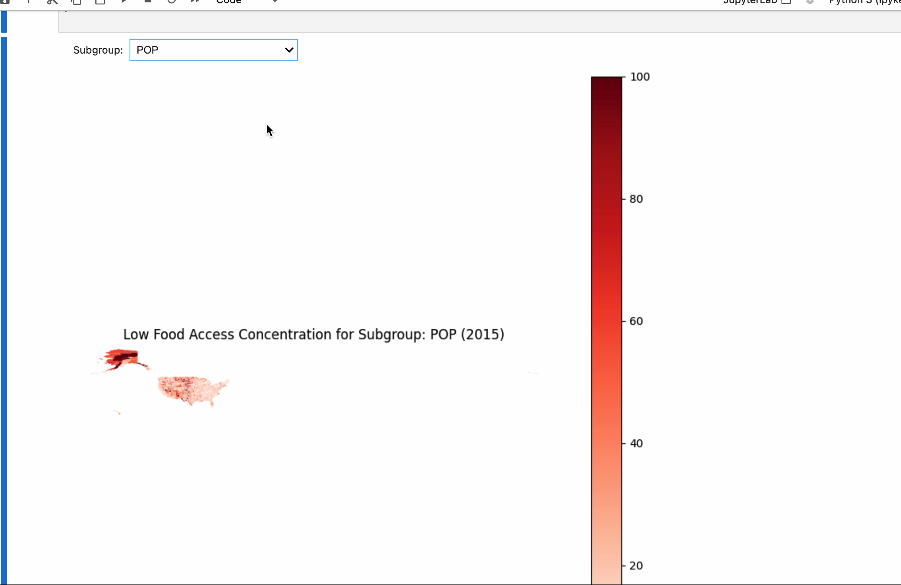
Understanding the Breakdown of Low Food Access Areas
Map of low access percentage in the US.
Subpopulation percentage concentration.
Overall population has low access concentration in the Midwest area, Southwest, and Alaska.
Alaska deeply affected through multiple subpopulations.
Highly affected subgroups contain low-income individuals, seniors, children, the white population concentrated in the Midwest, and the Hispanic and Native American population concentrated in the Southwest.

Slide 6

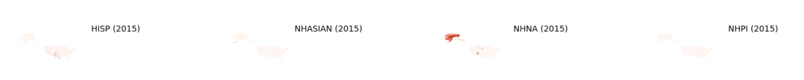

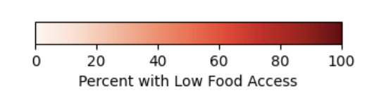
Understanding the Breakdown of Low Food Access Areas(Static Images)
Notes:
Map of low access areas
Chart showing overall target areas
Map for each subgroup
Chart showing each subgroup

Slide 7
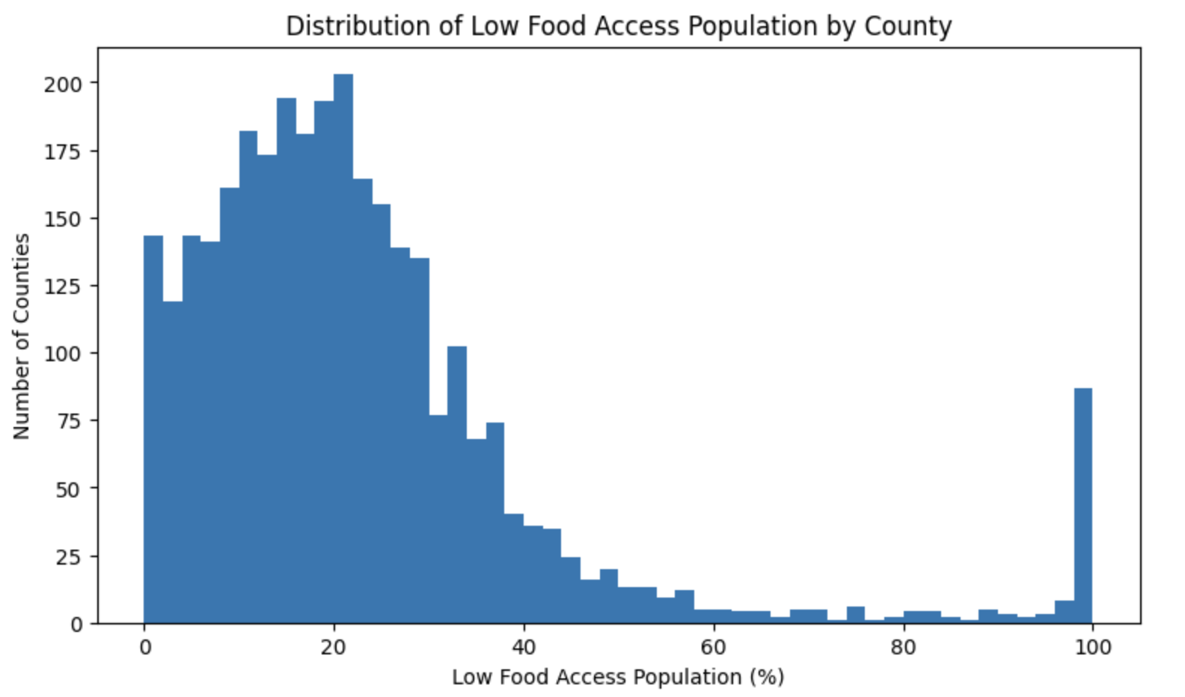
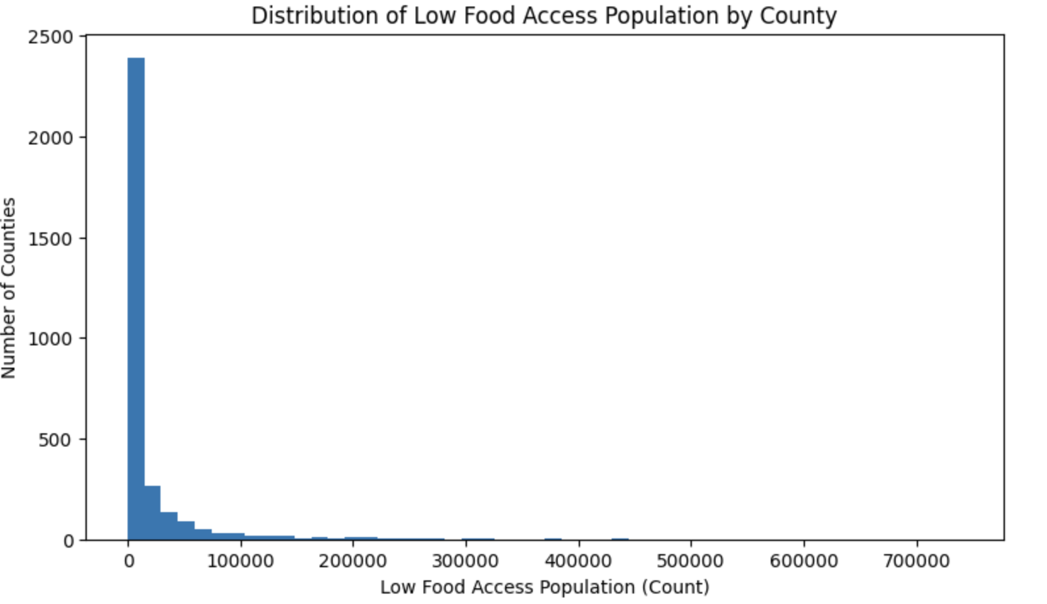
Total Low Access Population Breakdown
Right-skewed distribution of counts and percents, meaning more counties have a lower population/percentage of populations that have low food access.
This means our target counties with high populations of access necessities can be extracted and grouped.
We can use this knowledge to set a definition for what we will consider a low access county.
Counties at the top 10% of low access rates.
Notes:
Map of low access areas
Chart showing overall target areas
Map for each subgroup
Chart showing each subgroup

Slide 8
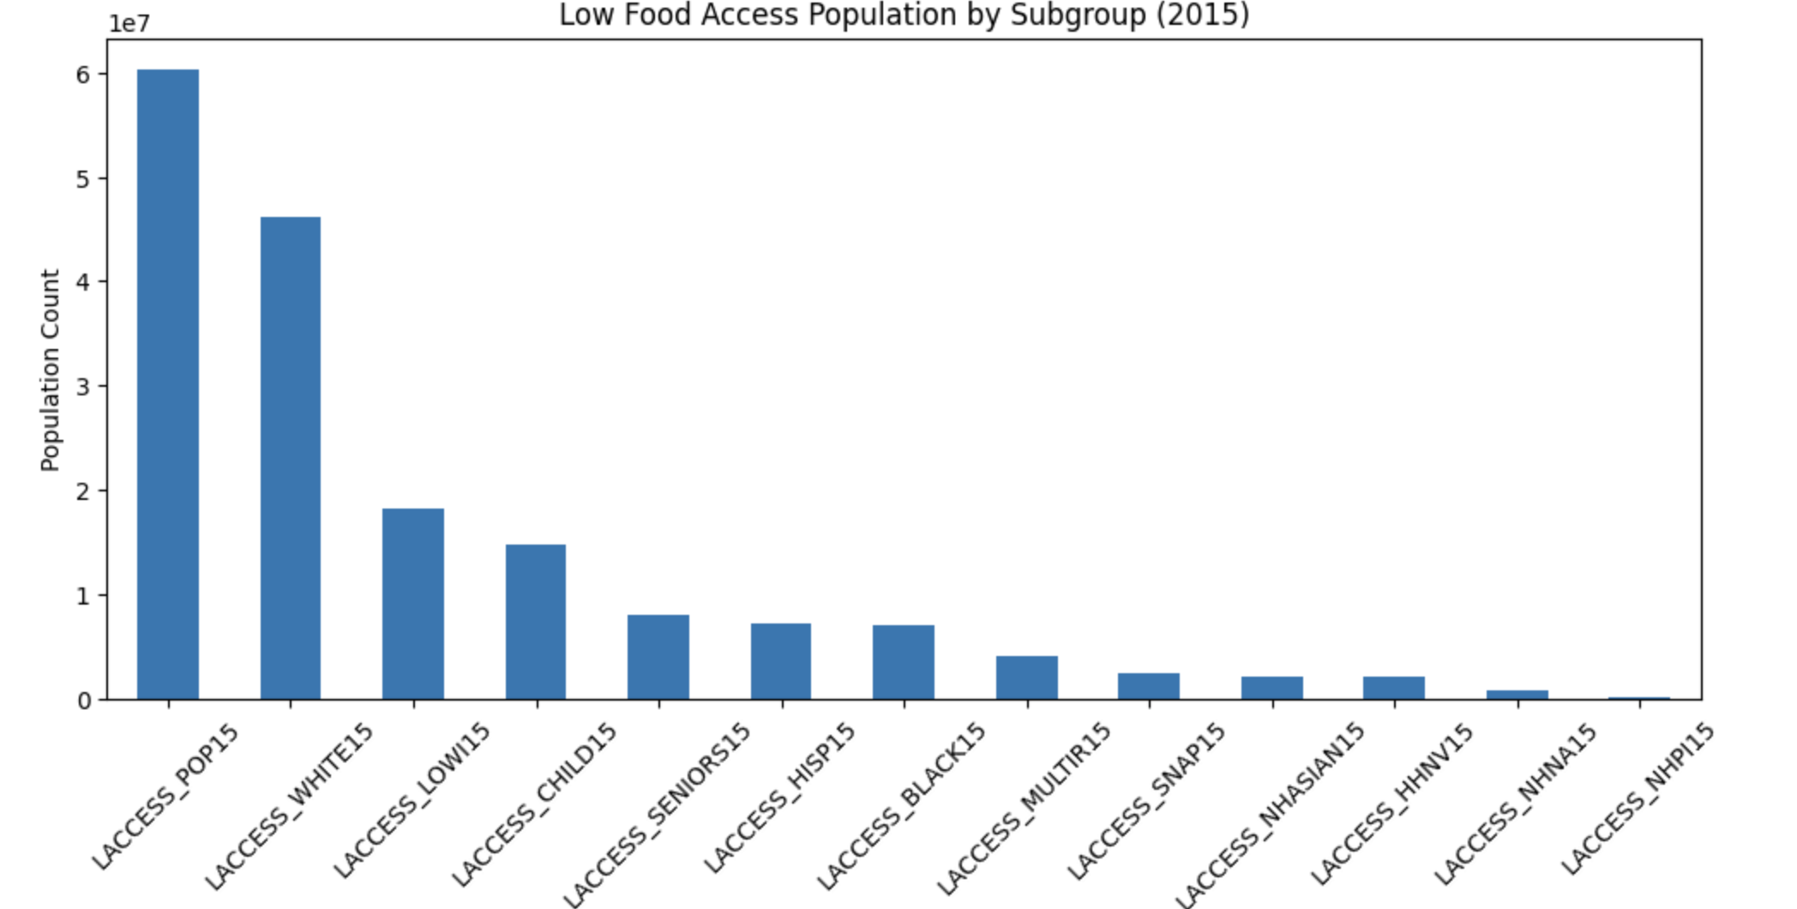
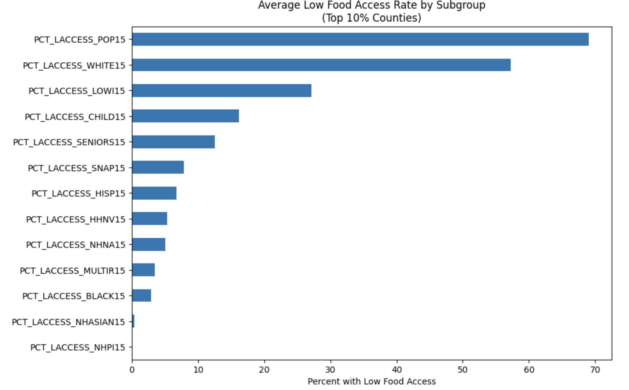
Subgroup Evaluation
White subpopulation
Followed by Low income

Slide 9
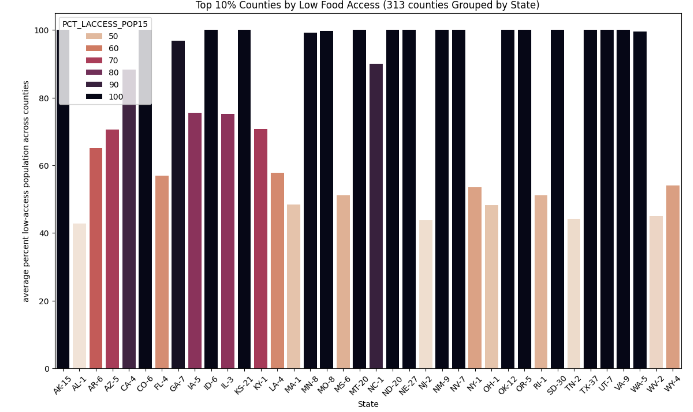
Plotting top 10% of Low Food Access Counties (313 total)
Total population count for this metric is about 2,545,992
Look for states with large concentration and larger count within counties.
TX, SD, NE, ND, MT, KS

Slide 10
Targeting further affected populations: Building a Health Issue Index
Lack of food access often leads to health issues caused by lack of nutritional food in combination with other unhealthy lifestyle habits.
We can assume those with nutrition-based health issues will have higher retention rates.
To quantify this target, we can use the 500 cities dataset. This dataset carries information regarding certain health indicators and their estimated 2017 crude prevalence rate at the tract level for 500 cities.
500 Cities health data captures adults only; child subpopulation is inferred as risk, not directly measured.
Our indicators will be overall physical health, obesity, high cholesterol, diabetes, and high blood pressure.
Rank tracts in percentiles for both.
We will look at top quartile in both measures.

Slide 11
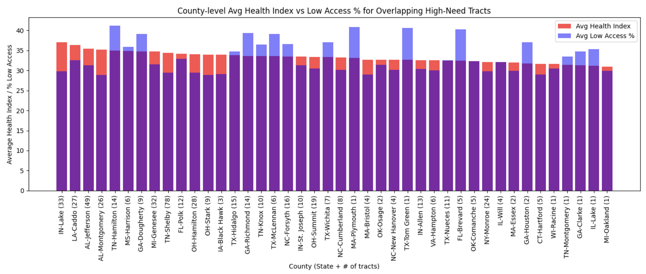
Top 10% Counties with high health indicator and high access need tracts.
Using health data shows trends for health and access issues in specific East/Southeastern areas as well.

Slide 12
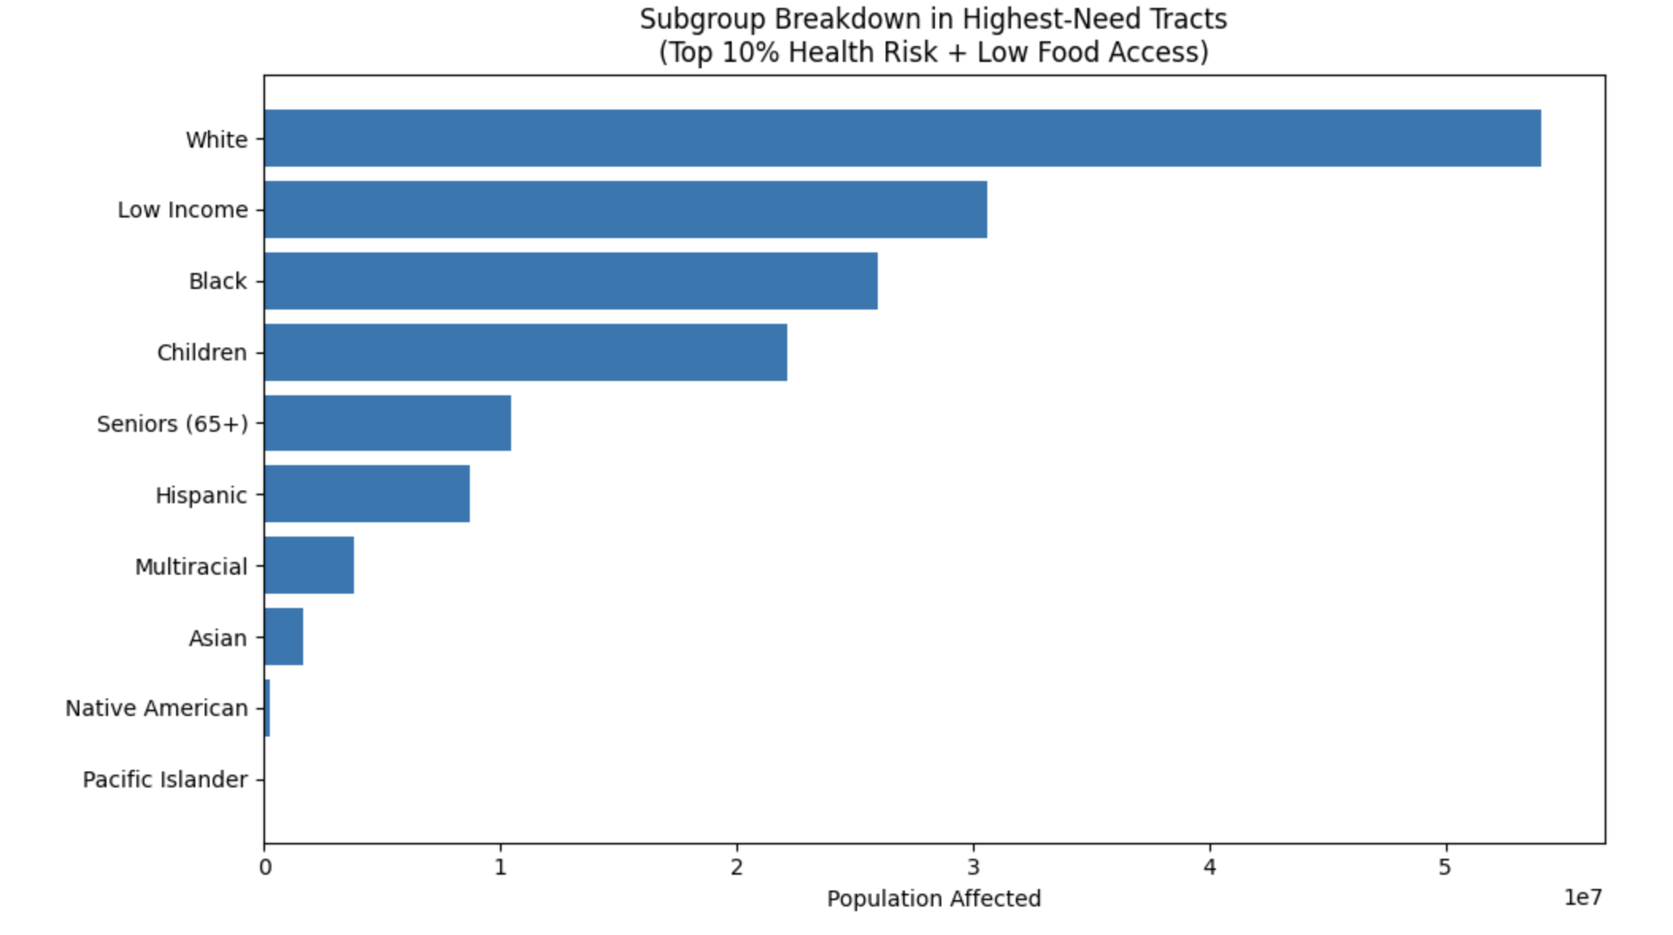
In these areas, the target subgroups are still white and low income, but they are closely followed by the black population. This differs from the total low access breakdown, and we should consider it a target subpopulation as well.

Slide 13
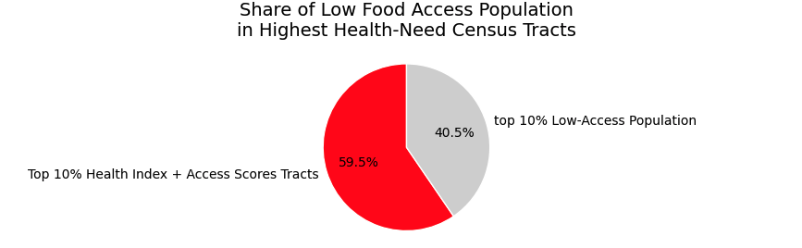
Projected Impact
By targeting high health index areas, we also cover over half of the top 10% of the low access rate population.
Since health index may indicate retention ability, let’s assume a retention rate of about 50% of the high index population, and 30% for just low access populations.
This gives us a total retention rate of around 30% if program deployed to top 10% low access rate populations.

Slide 14
Numeric Breakdown
Total reported low access population:
60,254,923
Top 10% of low access counties population(target):
2,545,992
Top 10% low access and health index population:
1,515,998
Approximated retention:
763,797

Slide 15
Summary of Areas to Target and Projected Impact
Midwestern, Southern/Southwest, and Alaskan regions
Few eastern US counties in states like IN, AL, TN, GA, LA, FL, NY, MI
White subpopulation
Low-income subpopulation
Black subpopulation
Reduce Top 10% Low Food Access population by about 30%

Slide 16
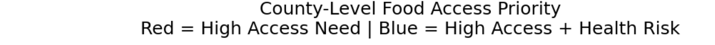
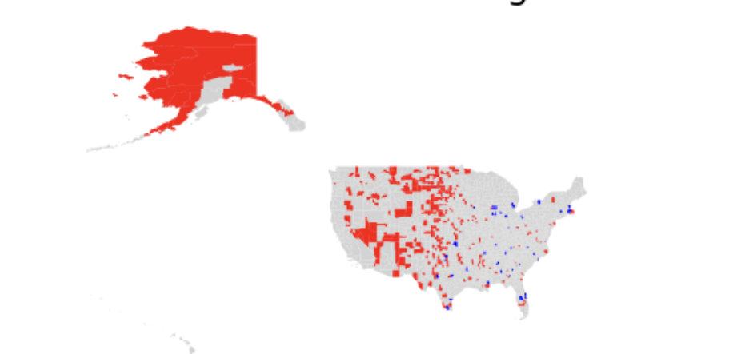
Summary of Areas to Target and Projected Impact
Aim to target all highlighted areas
Higher retention rates in blue areas due to health conditions.
Higher retention rates in Midwest regions due to extremely low access.
Health data coverage is incomplete. Red tracts without reported health data may also represent health risk areas.

Slide 17
Q & A

